Slide 1
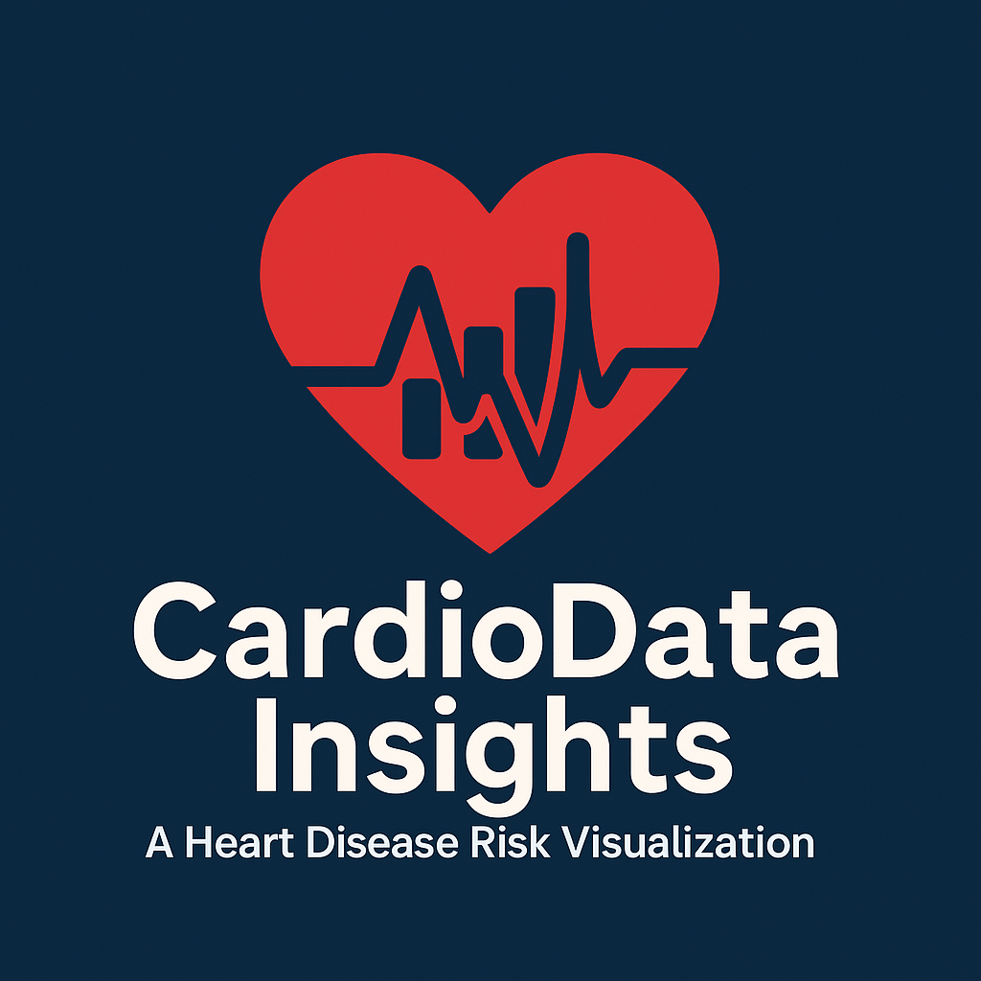
CardioData Insights:
A Heart Disease Risk Visualization
Team Name: BeatBytes
Team Members: Isaac Ferry, Josh Melchor-Nieto, and Jamie Almeida

Slide 2


Team Introduction
Team Introduction
Isaac: Lineplot, Correlation HeatMap, and a Radar Chart
Josh: Bar Charts, Box plot, and Interactive 3D Surface Plot
Jamie: Violin Chart, Interactive 3D Scatterplot, and a Pie Chart

Slide 3
Why We Chose This Topic
Number of deaths(%) in 2021 (USA)
Race or Ethnic Group | # of Deaths
American Indian or Alaska Native | 15.5
Asian | 18.6
Black (Non-Hispanic) | 22.6
Native Hawaiian / Pacific Islander | 18.3
White (Non-Hispanic) | 18.0
Hispanic | 11.9
All | 17.4
In the USA its the leading cause of death for men, women, and people of most racial and ethnic groups.
Every 33 seconds someone dies of cardiovascular disease
In 2022 1 and 5 people died from Coronary artery disease (most common type of heart disease)
Source: CDC
(also because it would look good on a resume)

Slide 4

Project Overview
a
Objectives:
Identify key risk factors for heart disease.
Validate clinical knowledge (e.g., BMI vs. blood pressure).
Significance:
Assists in preventive healthcare by highlighting modifiable risks (exercise, smoking, and blood pressure).
Dataset:
Source: Kaggle (Oktay Ördekçi), updated 5 months ago.
Metrics: Age, gender, cholesterol, exercise, family history, etc.

Slide 5
Implementation Method
Tools and Libraries:
Jupyter Notebook
Pandas
Matplotlib
Seaborn
Numpy
Visualization Techniques
Line Plot
Correlation Heatmap
Radar Chart
Justification:
Line Plot: Chosen to show the amount of people with and without Heart Disease in the dataset
Correlation Heatmap: Chosen to show the correlation between different variables and their relation to Heart Disease
Radar Chart: Chosen to show a easy to read view of the average levels of different variables of people with Heart Disease
Workflow:
Research different visualizations
Import dataset using pandas
Clean data using dropna
Used categorical variables or calculated metrics
Selected visualization chart

Slide 6
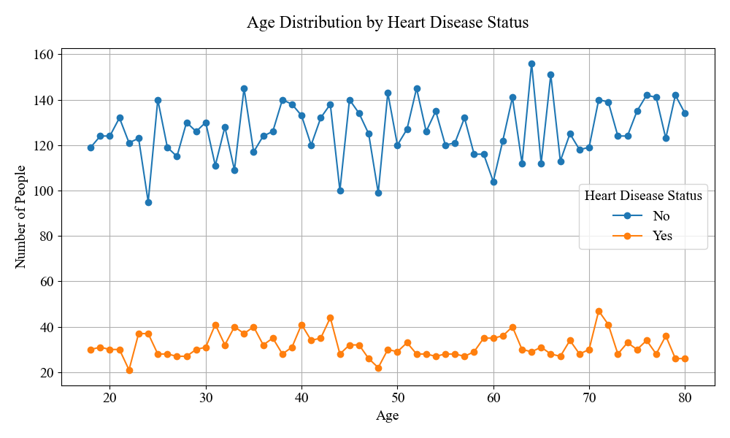
Visualization 1: Age Distribution by Heart Disease
Observations:
This dataset has many more people without heart disease
Heart disease line (red) surges sharply in the early 70s Notable "bumps" in heart disease frequency at 30s and 40s—likely tied to lifestyle or genetic risks
From mid 70s to 80s heart disease average is less than ages 30-40
Why This Matters:
Challenges the idea that only the elderly are affected by heart disease

Slide 7
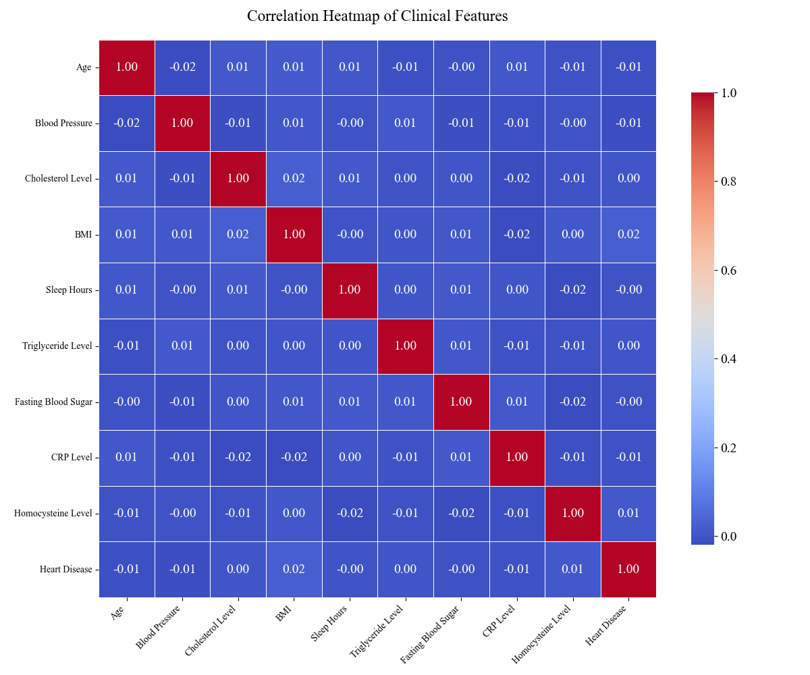
Visualization 2: Correlation of Clinical Features
Observations:
Little to no correlation with heart disease or each other
This implies that not a single value is a strong contributor to heart disease
Why This Matters:
This data suggests that heart disease is caused by multiple variable.
It can indicate that the data is artificially created.

Slide 8
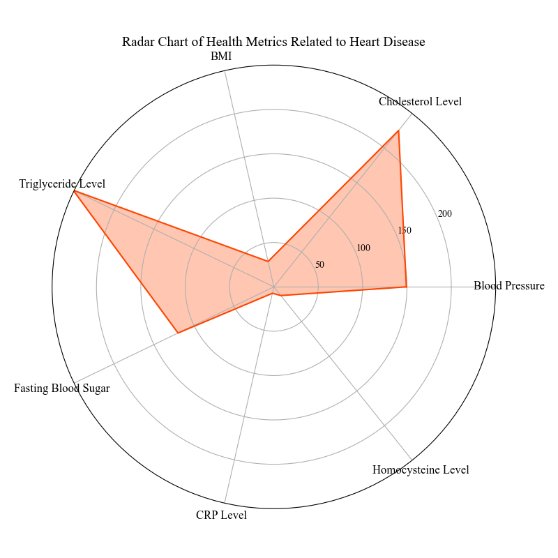
Visualization 3: Health Metrics by Heart Disease Status
Observations:
Individuals with heart disease exhibit significantly elevated triglyceride and cholesterol levels.
Fasting blood sugar levels are moderately high, suggesting a link to prediabetes or diabetes.
Why This Matters:
Identifying these clustered risk factors can help target early interventions to help reduce heart disease

Slide 9
Implementation Method
Workflow:
Import dataset using pandas
Handle missing values with “dropna()’
Used categorical variables or calculated metrics
Selected visualization chart
Tools and Libraries:
Jupyter Notebook
Pandas
Matplotlib
Plotly
Seaborn
Visualization Techniques
Violin Plot
Interactive 3D Scatterplot
Pie Chart
Justification:
Violin Plot: Chosen to show distribution density and outliers
Interactive 3D Scatterplot: Reveals multidimensional correlations
Pie Chart: Simplified comparison of prevalence rates

Slide 10
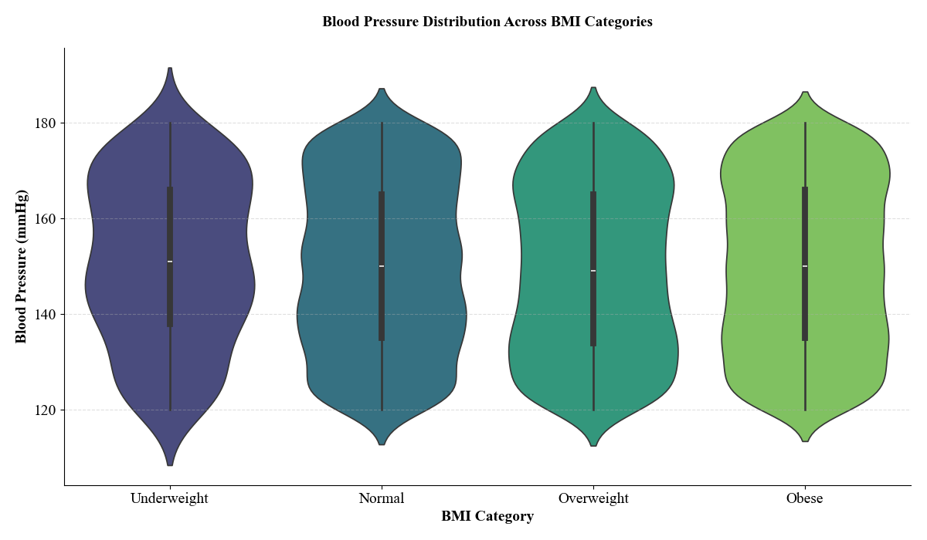
Visualization 4: Blood Pressure Distribution
Observations:
Unexpected median trend (underweight and obese share a close blood pressure value)
Overweight group has the largest IQR while the Underweight group has the smallest
Why This Matters:
Public Health: Reinforces obesity prevention
Clinical Insight: Confirms the link between obesity and hypertension

Slide 11
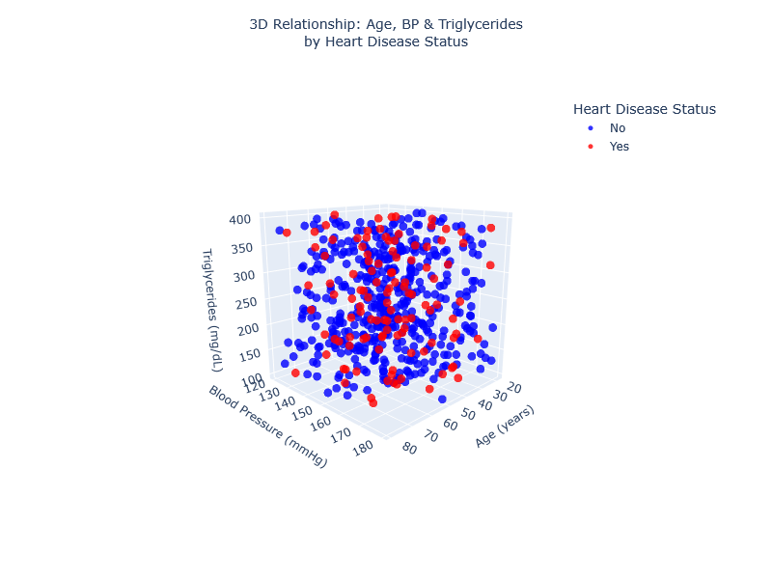
Visualization 5: Cardiovascular Risk Factors
Observations:
Red dots were not clustered in expected areas
Blue dots dominate lower ranges but appear at higher values.
Why This Matters:
Research Validation: Challenges assumptions that risk factors act in isolation
Clinical Utility: Helps health professionals identify high-risk profiles (elderly patients with rising triglyceride levels).

Slide 12
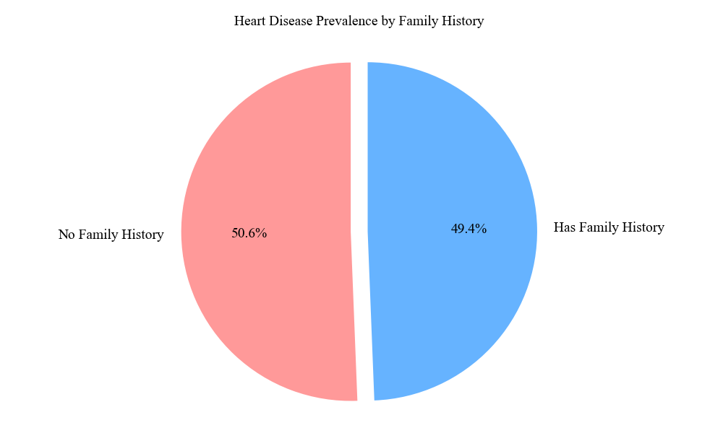
Visualization 6: Family Medical History of Heart Disease
Observations:
Near equal split meaning that genetics are a risk factor
Lifestyle choices in “No Family History” group are greatly offsetting genetic advantage.
Why This Matters:
Research Validation: Reinforces the need for universal screening
Clinical Utility: Highlights the importance of personalized prevention
CEO
CFO
Sales Director
Berry Books
Vinny Viewer
Wendy Writer

Slide 13
Implementation Method
Tools and Libraries:
Jupyter Notebook
Pandas
Matplotlib
Seaborn
Plotly
Numpy
Workflow:
Import dataset using pandas.
Gather group only necessary information and filter out unwanted variables.
Find averages based on different groups.
Selected visualization chart
Justification:
Clustered Bar Plot: allows to plot multiple grouped variables as one.
Box Plot: shows averages for different variables to see where majorities lie.
Interactive 3D Surface Plot: Reveals multi variable patterns while reducing noise
Visualization Techniques
Clustered Bar Chart
Boxplot
Interactive 3D Surface plot

Slide 14
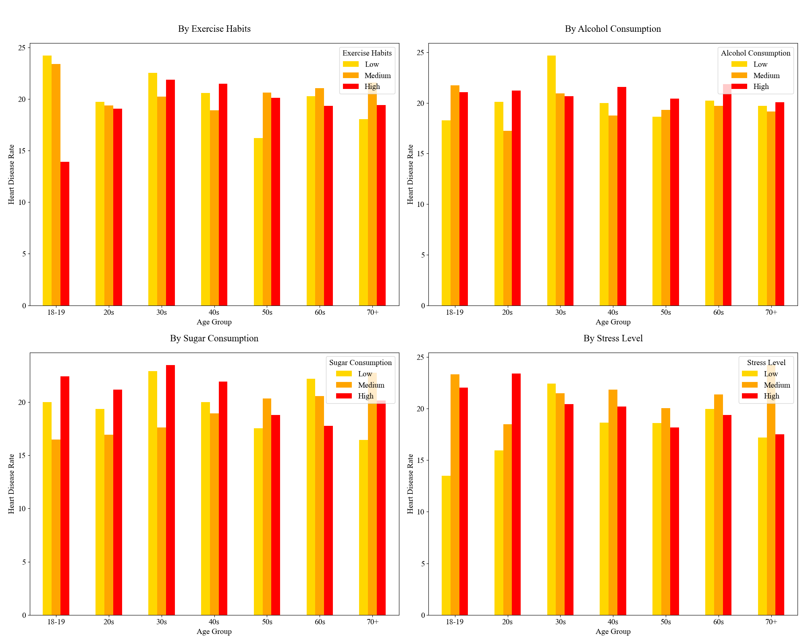
Visualization 7: Heart Disease Likelihood Across Age and Lifestyle Habits
Observations:
Good habits overall reduces the risk of heart disease.
Sugar consumption has less impact than the other habits.
Stress impacts younger people the most.
Why This Matters:
Visual proof that lifestyle habits play a role in overall health
Enforces claims about healthy dieting and exercise.

Slide 15
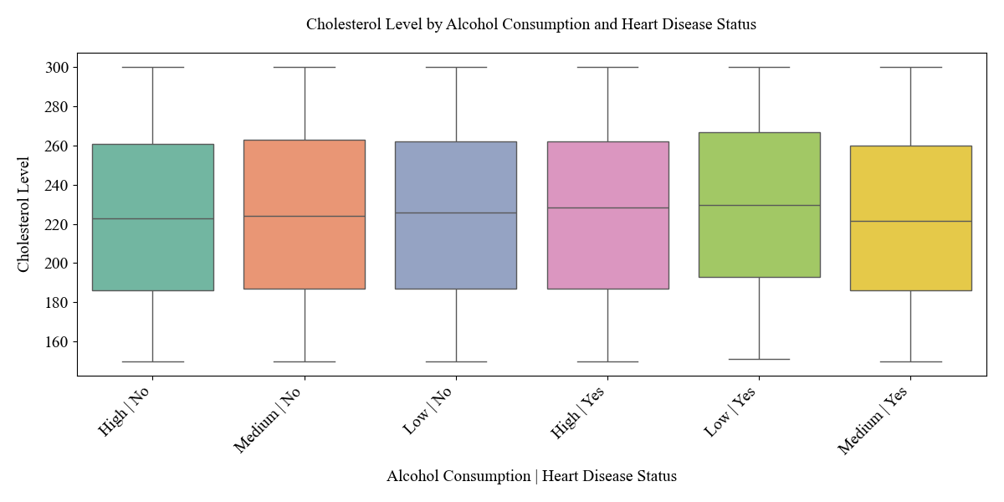
Visualization 8: Cholesterol Variability by Alcohol Intake
Observations:
The average cholesterol level for drinking across the board is about 220.
There may be other contributing factors to cholesterol, or other variables that contribute to cholesterol more than alcohol.
Why This Matters:
Public Health: Alcohol is a major contributing factor to heart disease.
Clinical Action: Identifies medium alcohol intake as highest-risk zone for cholesterol spikes in at-risk patients.

Slide 16
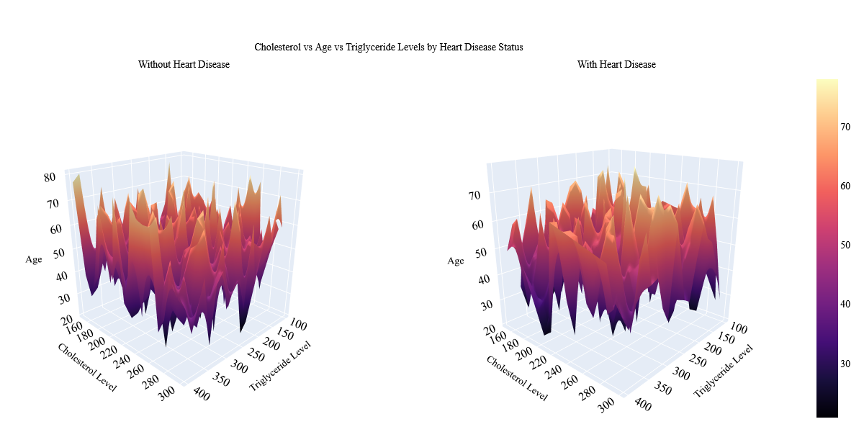
Visualization 9: Health Factors by Heart Disease Status

Slide 17
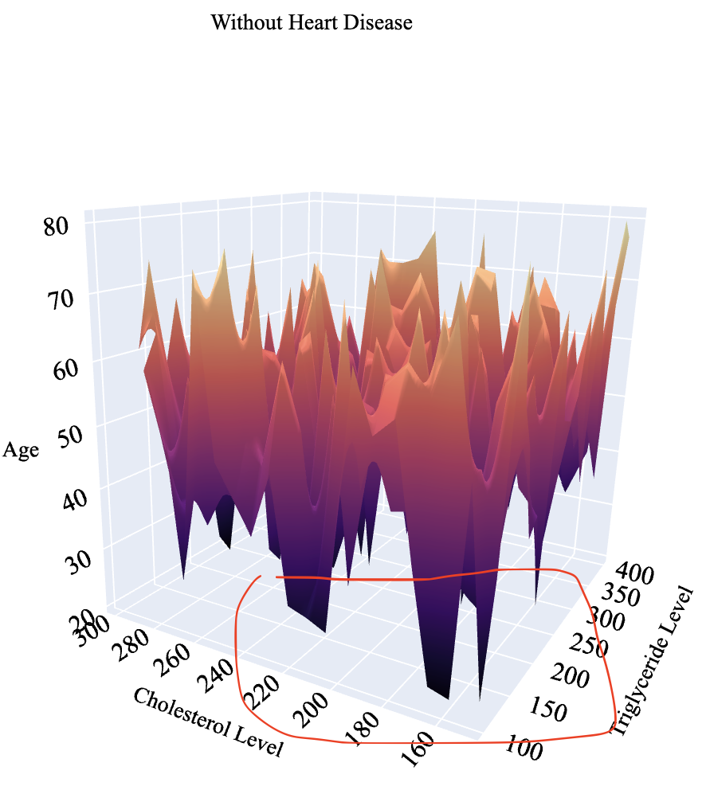
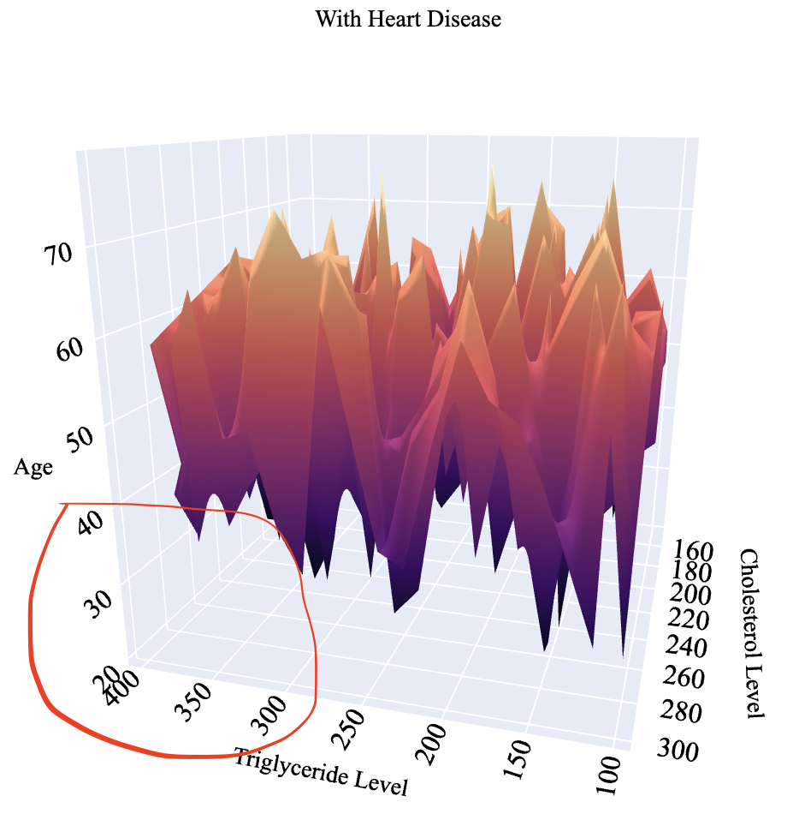
Cont. of Visualization 9
Observations:
No Heart Disease: Most people below the age of 30 have lower triglyceride and cholesterol levels
With Heart Disease: Only those between the ages 40-70 year old have the highest levels of cholesterol and triglyceride
Why This Matters:
Public Health: Visualizes the "metabolic storm" period (40s-50s) needing targeted education.
Clinical Strategy: Helps with both prevention and treatment as individuals should watch their triglyceride and cholesterol levels and those between 40-50s need to have a carefully planned diet.

Slide 18
Key Findings & Conclusion
Validated Clinical Knowledge
Obesity correlates with hypertension
Increased risk as an individual ages
Valuable Insights
Habits such as poor exercise and high sugar diets increase an individual's risk
Medium to High alcohol consumption worsens an individual's cholesterol
Impact
Health experts need to advocate for regular screenings
Ages of 20-30 can avoid worsening health through lifestyle choices
Doctors should investigate each and every anomaly they come across

Slide 19
Questions?

Slide 20

Thank you!
Stay Healthy!

